Slide 1
Super Store Sales Analysis

Slide 2
Table of contents
01
02
03
04
05
06
Problem Statement
Stakeholders
KPI’s
Recommended Analysis
Final Report
Conclusion

Slide 3
Problem Statement
ShipFast Logistics is facing challenges with shipment delays and rising shipping costs, affecting customer satisfaction and profitability. As a data analyst, your task is to analyze shipment data to identify patterns, reduce delays, and optimize costs to improve delivery times and overall operational efficiency.

Slide 4
Stakeholders
Internal Stakeholders:
Logistics Team
Finance Department
Customer Service Team
External Stakeholders:
Customers
Shipping Partners

Slide 5
KPI’s(Key Performance Indicator)
2.3M Total Sales
₹442.53K Total Profit
5000 Total Orders
₹229.86 Avg Sales
783 Total Customer

Slide 6
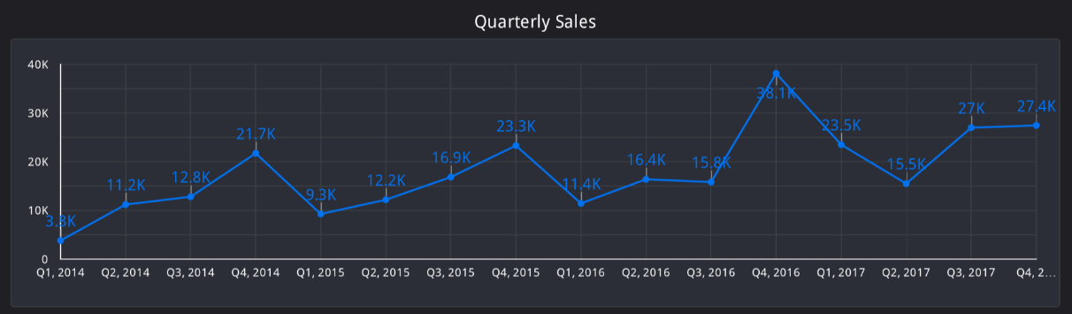
Recommended Analysis
Q1. Find the Quarterly Sales?

Slide 7
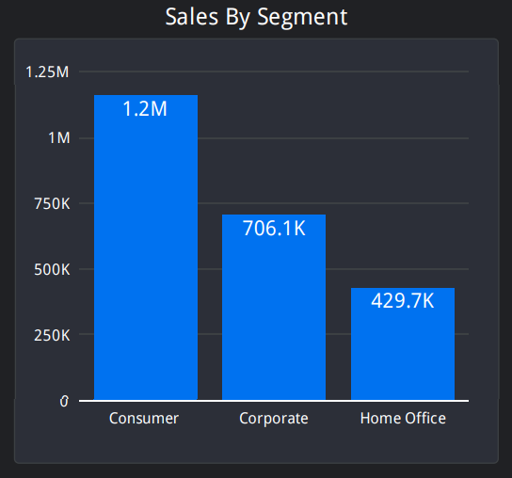
Recommended Analysis
Q2. Calculate Total Sales in Each Segment?

Slide 8
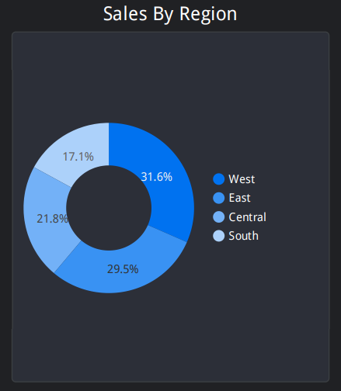
Recommended Analysis
Q3. Calculate Total Sales in Each Region?

Slide 9
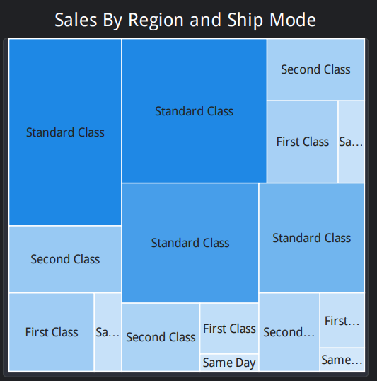
Recommended Analysis
Q4. Calculate Total Sales by Region and Payment Mode

Slide 10
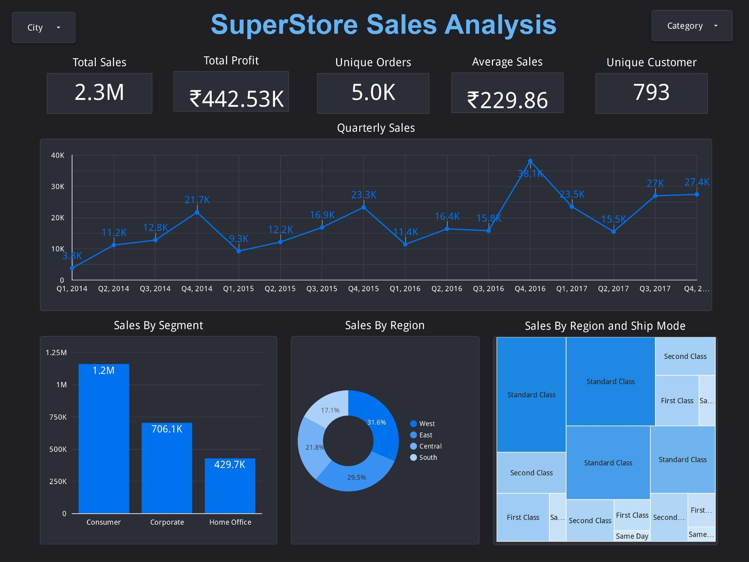

Slide 11
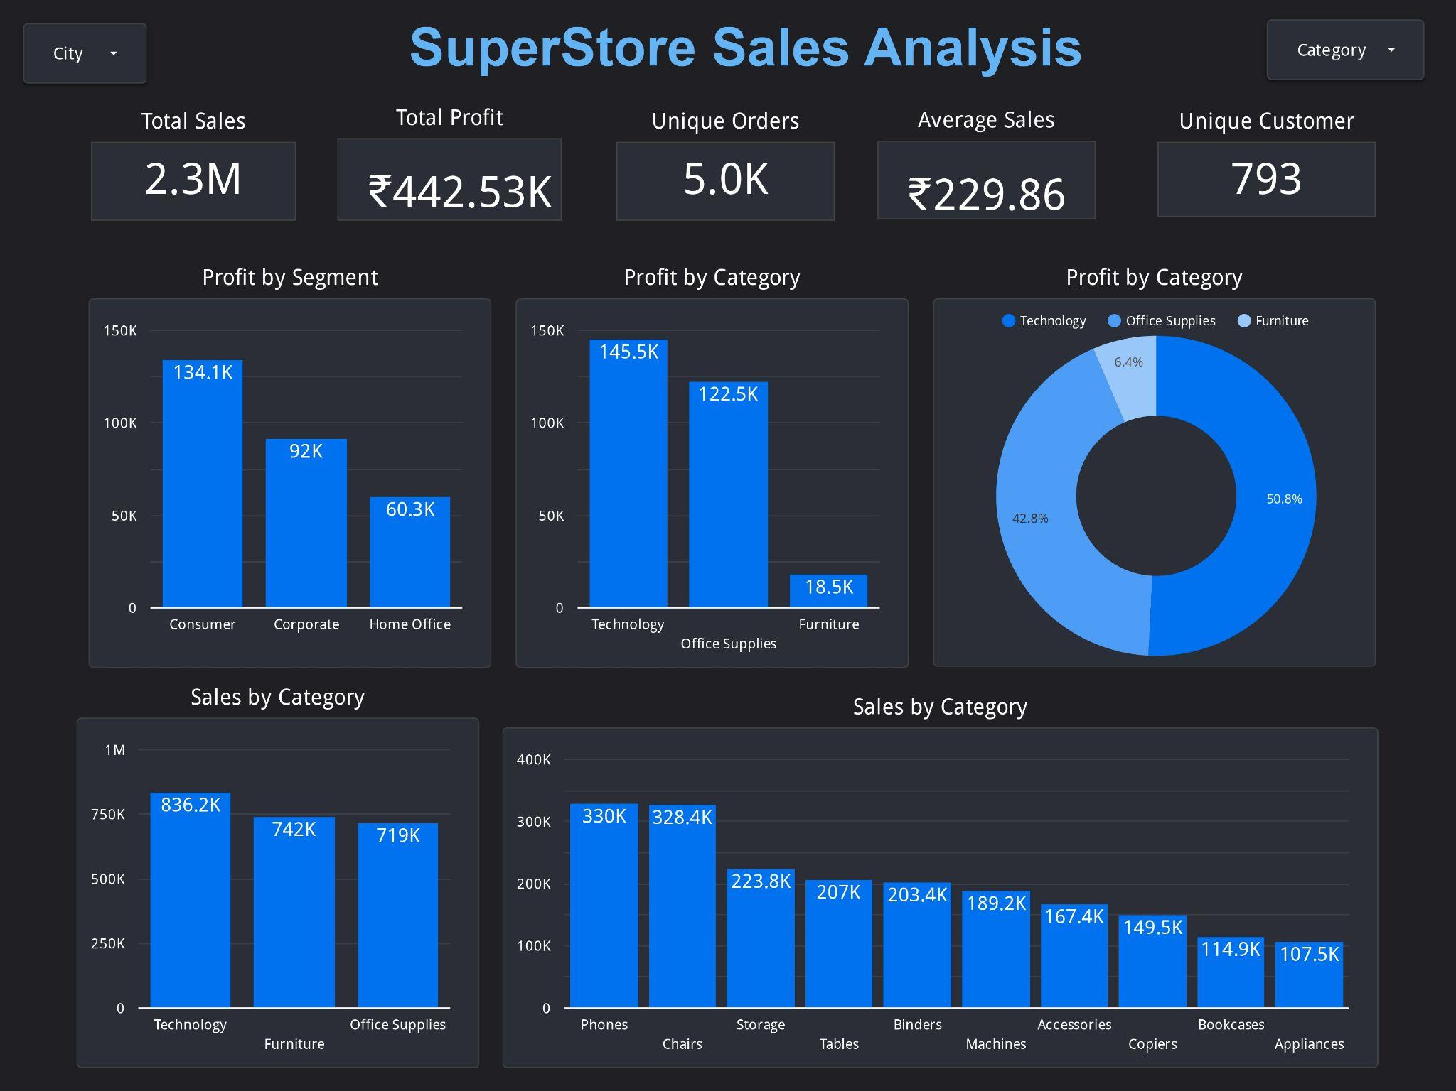

Slide 12
Thanks!

